Slide 1
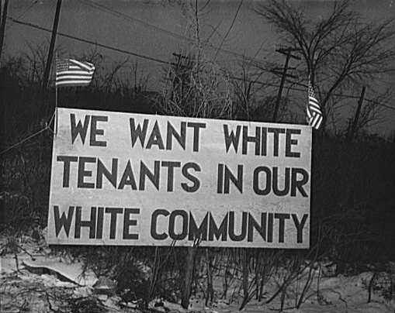
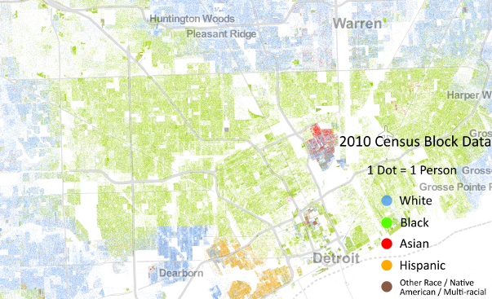
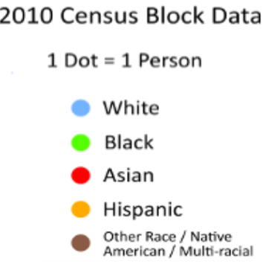
SIA & ABM Talk: Homophily & Segregation
Detroit, 1942
Detroit, 2010
ORGANIZED SEGREGATION
Housing market discrimination
UNORGANIZED (SELF-ORGANIZING) SEGREGATION
Schelling (1969,1971): Some results of segregation can emerge from the interplay of individual preferences of people for similar ones within spatial constraints, without negativity towards out-group
SIA: identification, categorization
Rocco Paolillo, I SIAM workshop
Notes:
Census Block data: “Image Copyright, 2013, Weldon Cooper Center for Public Service, Rector and Visitors of the University of Virginia (Dustin A. Cable, creator) https://demographics.coopercenter.org/racial-dot-map#thedata”
Schelling, T. C. (1969). Models of segregation. The American Economic Review, 59(2), 488-493.
Schelling, Thomas C. 1971. "Dynamic models of segregation." The Journal of Mathematical Sociology 1 (2):143-86. doi: 10.1080/0022250X.1971.9989794.
Housing discrimination: Flage, A. (2018). Ethnic and gender discrimination in the rental housing market: Evidence from a meta-analysis of correspondence tests, 2006–2017. Journal of Housing Economics, 41, 251-273.

Slide 2
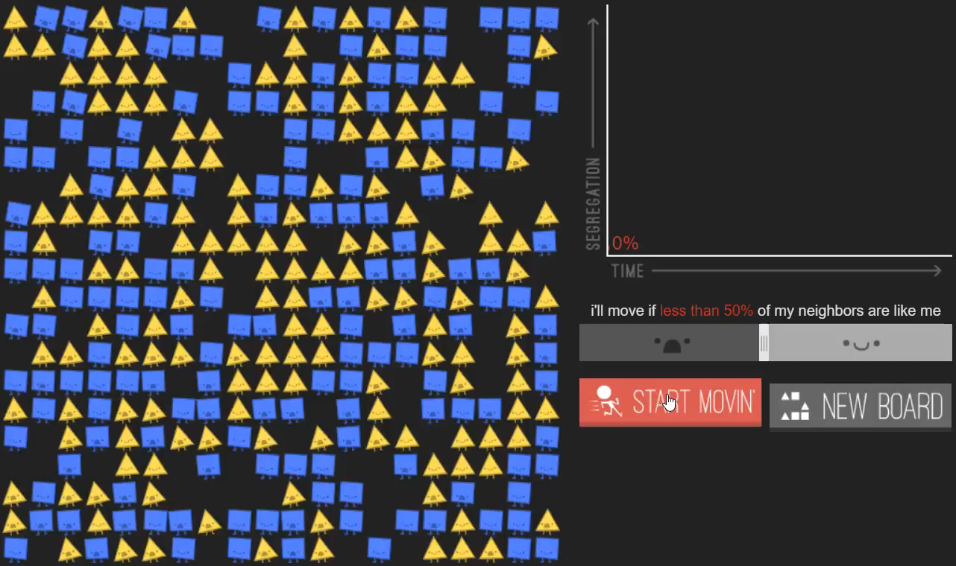
Micro: Preference
Threshold: desired concentration of similar ones to be happy with neighborhood, defines tolerance to out-groups
Interaction
Tipping point: as out-groups move, unhappy residents will move out, changing neighborhood composition
Macro: Segregation
https://ncase.me/polygons/
Notes:
https://ncase.me/polygons/

Slide 3
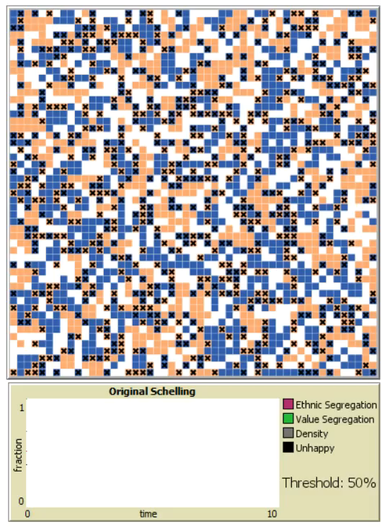
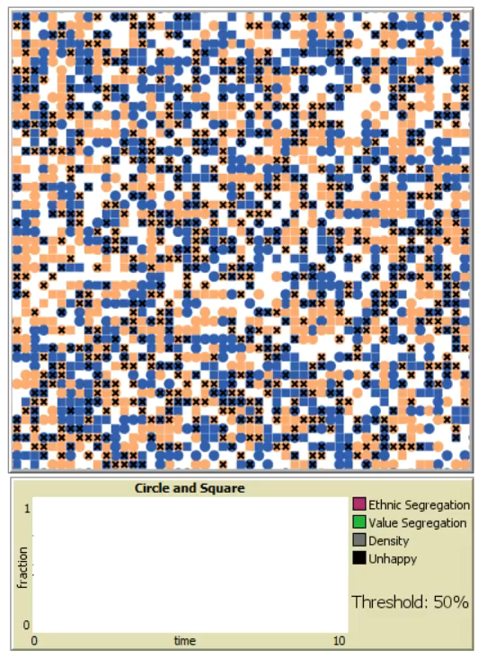
SIA: salience, categorization
Schelling (1969): similarity: twofold, exhaustive, and recognizable (p.488)
Super-diverse societies
New drivers to spatial sorting (Gent et al. 2019)
cross-ethnic category:
value homophily
(Wimmer 2013)
shape tag: value
Tolerant value-oriented
color tag: ethnicity
Intolerant ethnicity-oriented
Paolillo, R., & Lorenz, J. (2018)
Notes:
Gent, Wouter van, Marjolijn Das, and Sako Musterd. 2019. “Sociocultural, Economic and Ethnic Homogeneity in Residential Mobility and Spatial Sorting Among Couples.” Environment and Planning A: Economy and Space 51 (4): 891–912.
Wimmer, Andreas. 2013. Ethnic Boundary Making: Institutions, Power, Networks. Oxford University Press.
Paolillo, R., & Lorenz, J. (2018). How different homophily preferences mitigate and spur ethnic and value segregation: Schelling’s model extended. Advances in Complex Systems, 21(06n07), 1850026.

Slide 4
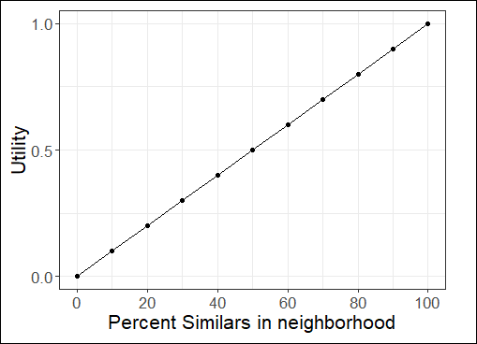
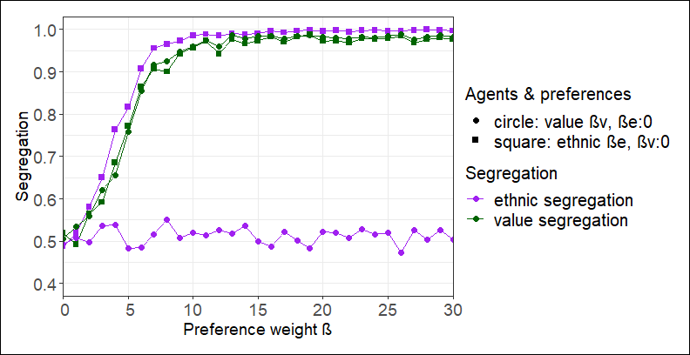
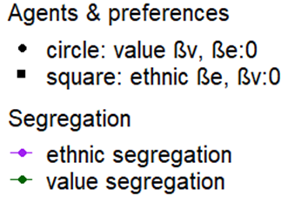
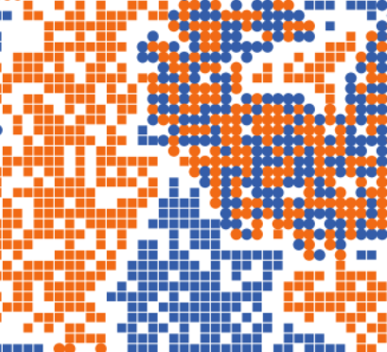
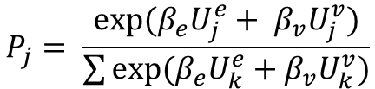
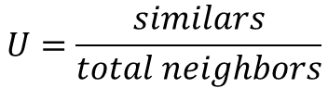
Decision making of agents: applying discrete choice models
Advantage of ABM
complexity of system
Utility function
cognition → behavior
$$U=\frac{similars}{total neighbors}$$
Interaction & mutual adaptation
Choice function
emergence of complex phenomenon
$$P_{j}= \frac{exp⁡(β_{e}U_{j}^{e}+ β_{v}U_{j}^{v})}{\sum{exp⁡(β_{e}U_{k}^{e}+β_{v}U_{k}^{v})}}$$
Benefit from SIA
complexity of individuals
How categorization of other agents works
How identity underlying different preferences is built
Paolillo,R. & Flache, A. (work in progress)

